Slide 1
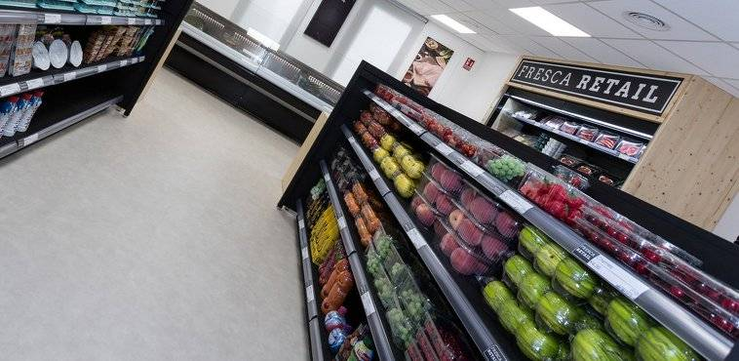
SALES PREDICTION Consumer buying behavior and product recommendation
Benny Stephen – DSI+6-Sydney

Slide 2
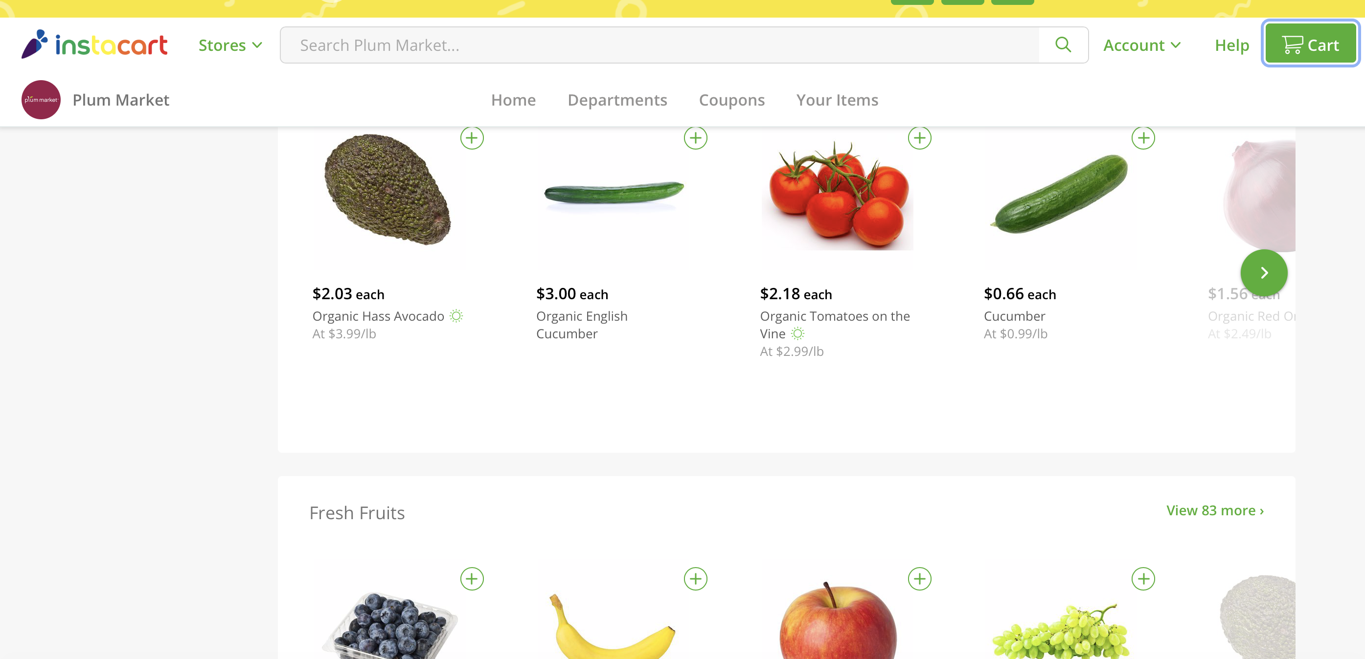

Slide 3
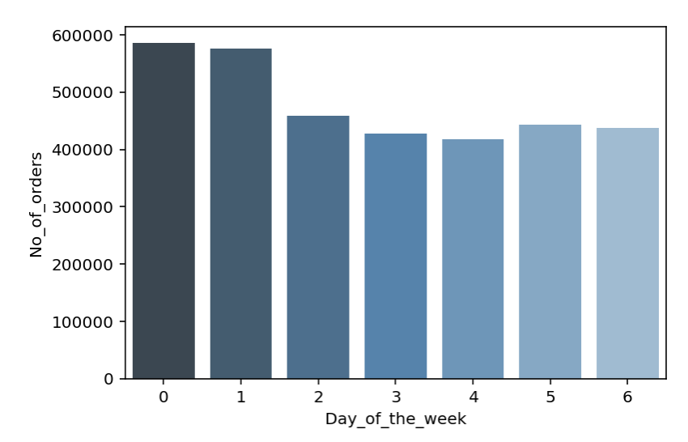
Distribution of sales - during the week
Notes:
Distribution of orders among the days of the week

Slide 4
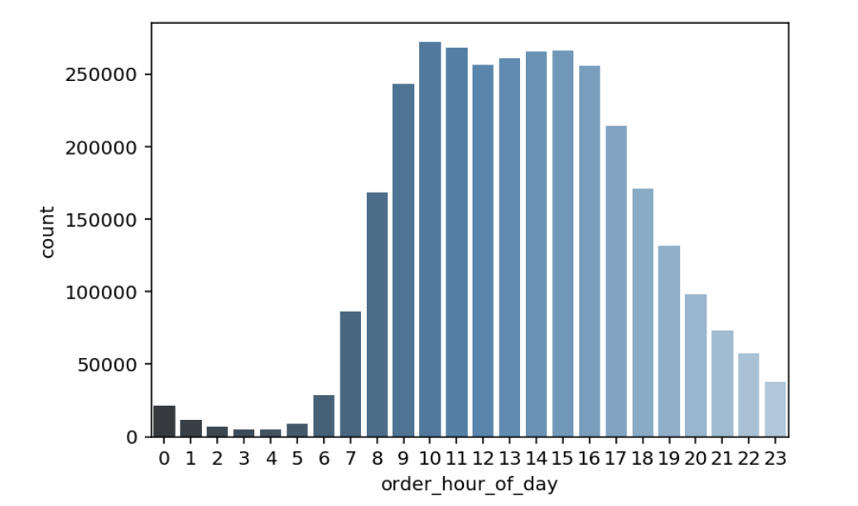
Distribution of sales - during the day

Slide 5
Distribution of sales - by aisle

Slide 6
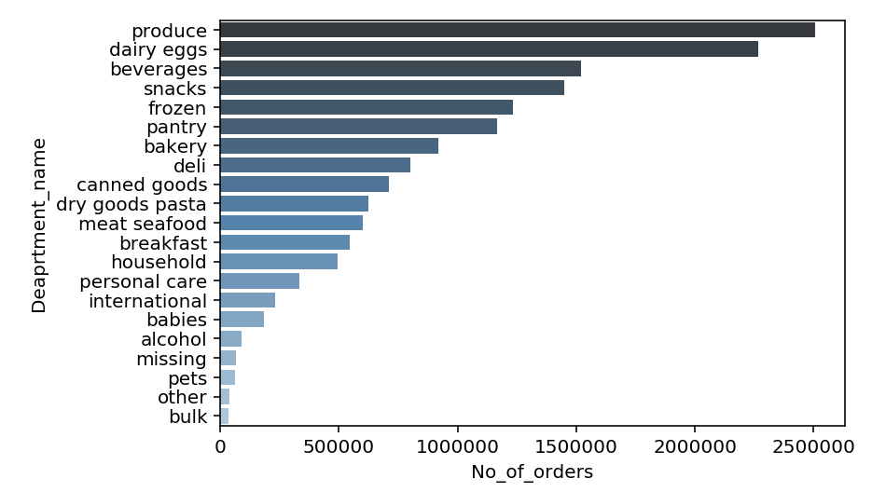
Distribution of sales - by department

Slide 7
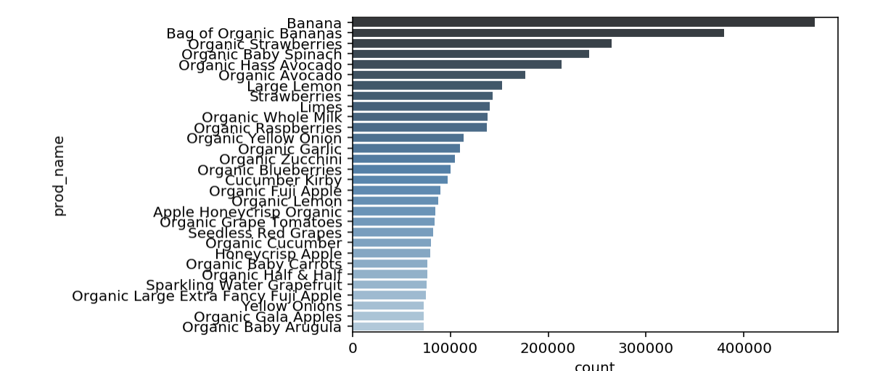
Distribution of sales - by product

Slide 8

Number of orders - by order interval
Count
Order Interval

Slide 9
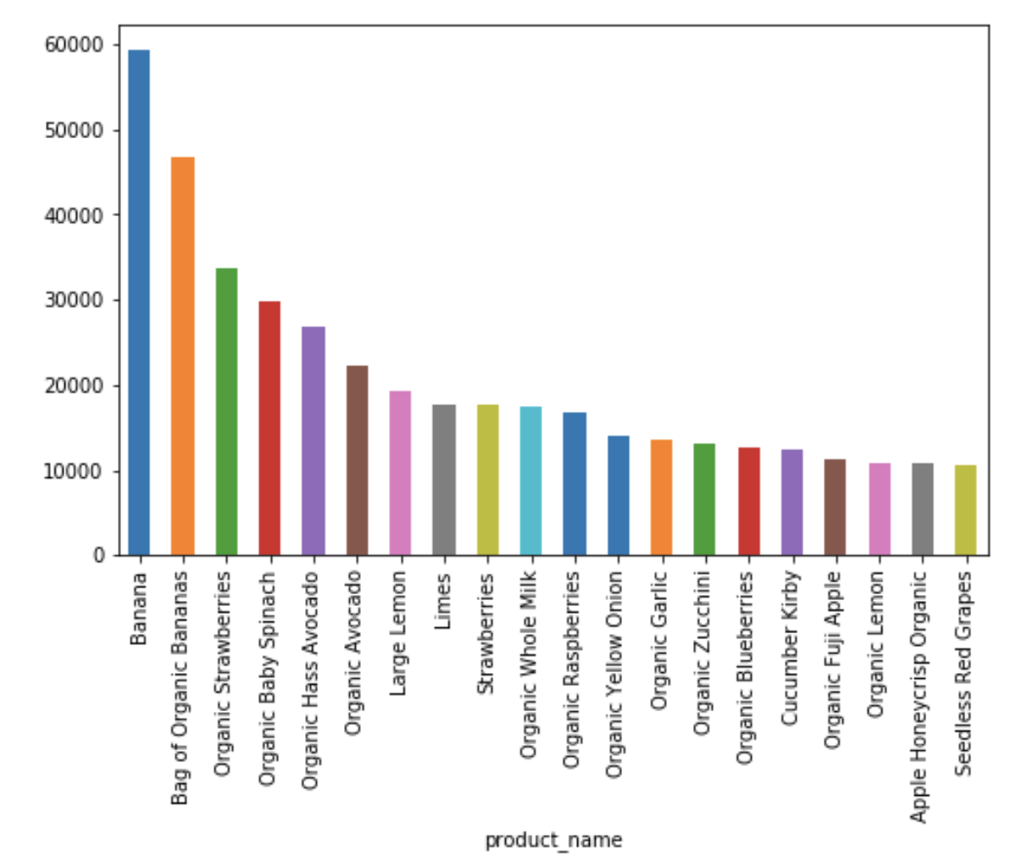
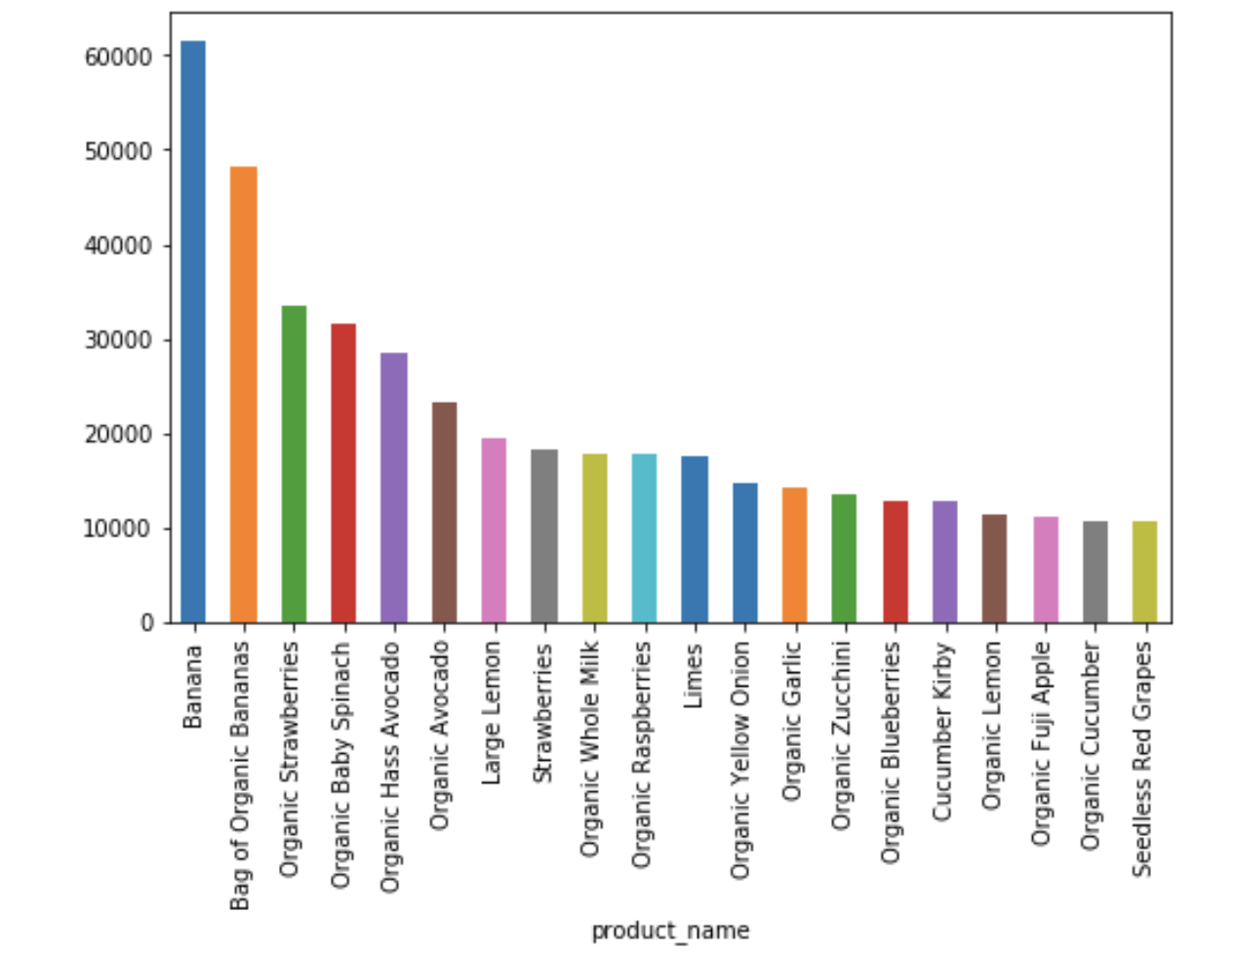
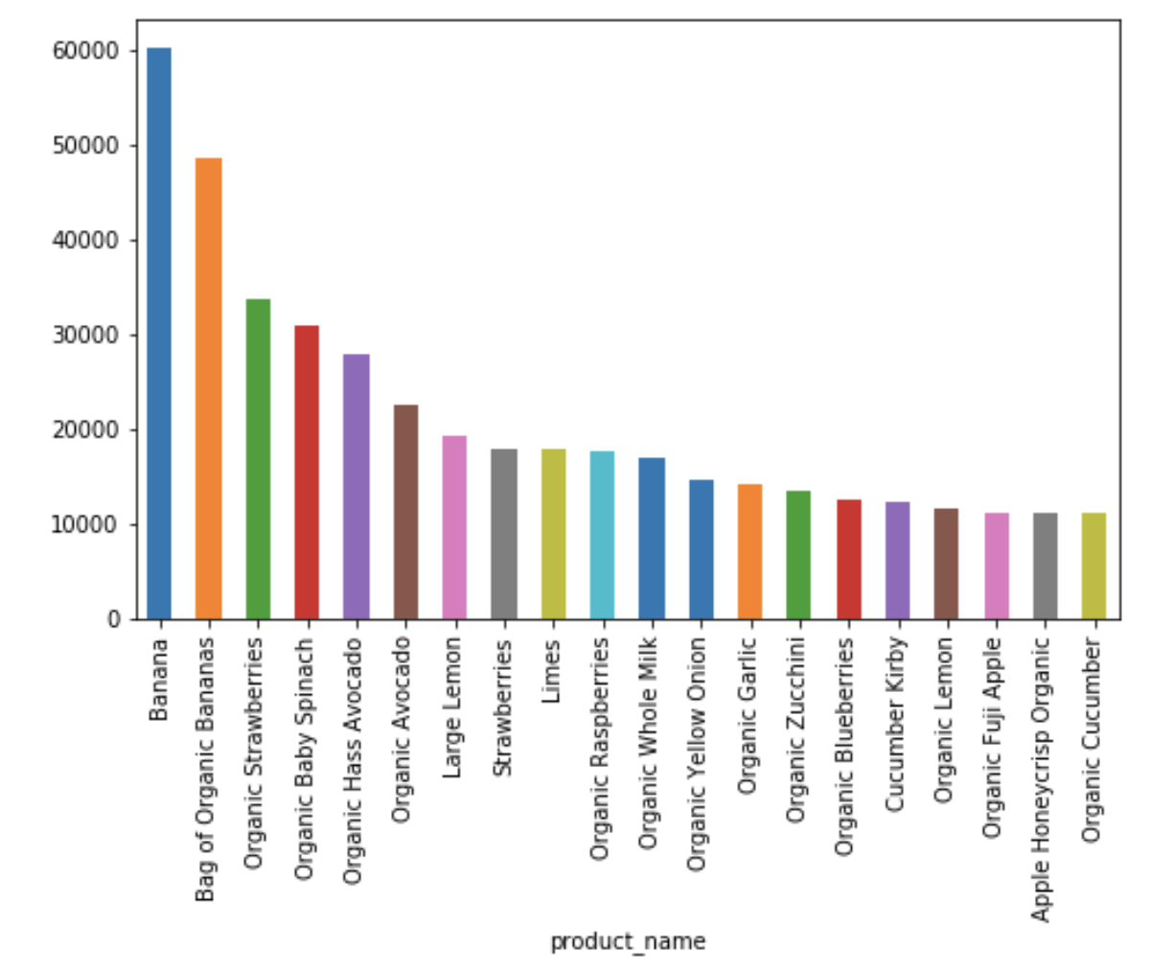
Distribution of sales - by cluster

Slide 10


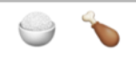
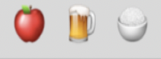
Sample order pattern
 | 4
 | 3
 | 3
 | 2
 | 2
 | 2

Slide 11
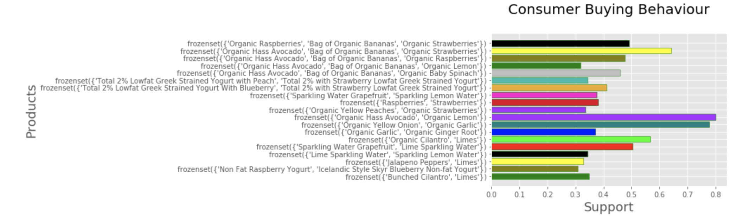
Consumer Buying Behavior

Slide 12
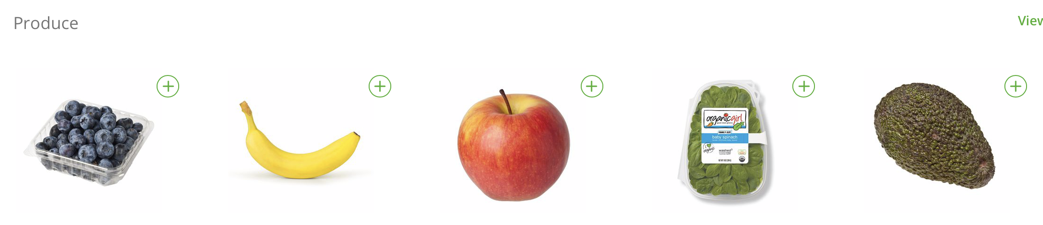
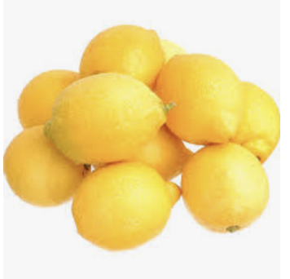
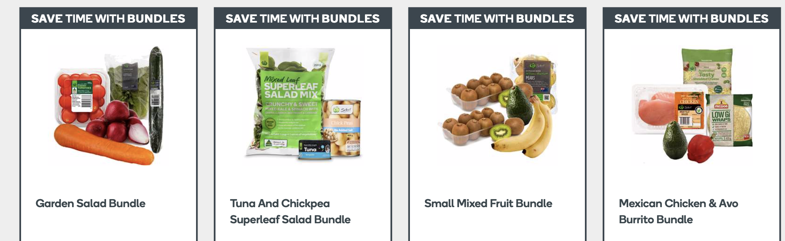
Product recommendation

Slide 13
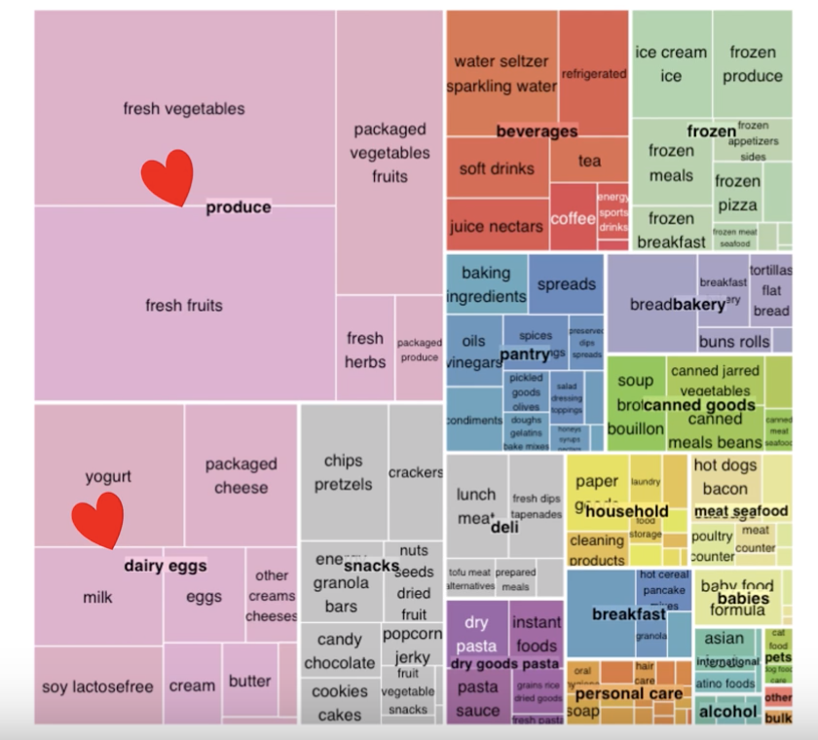
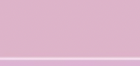
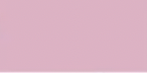
Store planner

Slide 14
Future Plans
Collect more data, fine tune the model and create a web page.

Slide 15
Thank You

